Slide 1
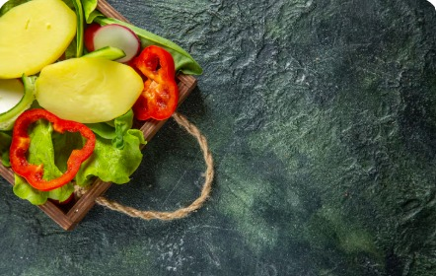

Culinary Competition 2025
Online Culinary Competition Website
Instructor:
Prof. Ramsha Khalid
Submitted by:
Ayesha Sarwar
Aqsa Munir
Areej Zainab
Soaiba Muzahir
Tooba Umair

Slide 2
Objectives
Our objective to create a website to organize a culinary competition :
Where people can showcase their cooking skills
Where skills meet opportunity
The winner get their reward’
Top 5 chef would given opportunity to become a professional chef

Slide 3
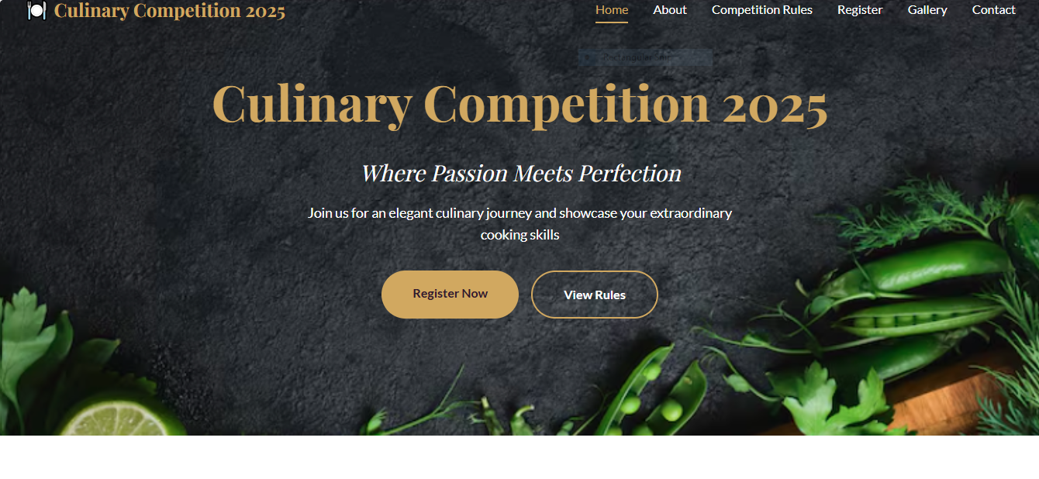
Home Page
Culinary Competition Website
Overview Content :
HTML & CSS based website for Culinary Competition 2025
Home page introduces event theme and purpose
Clear navigation: Home, About, Rules, Register, Gallery, Contact
Call-to-action buttons for quick registration and rules access

Slide 4
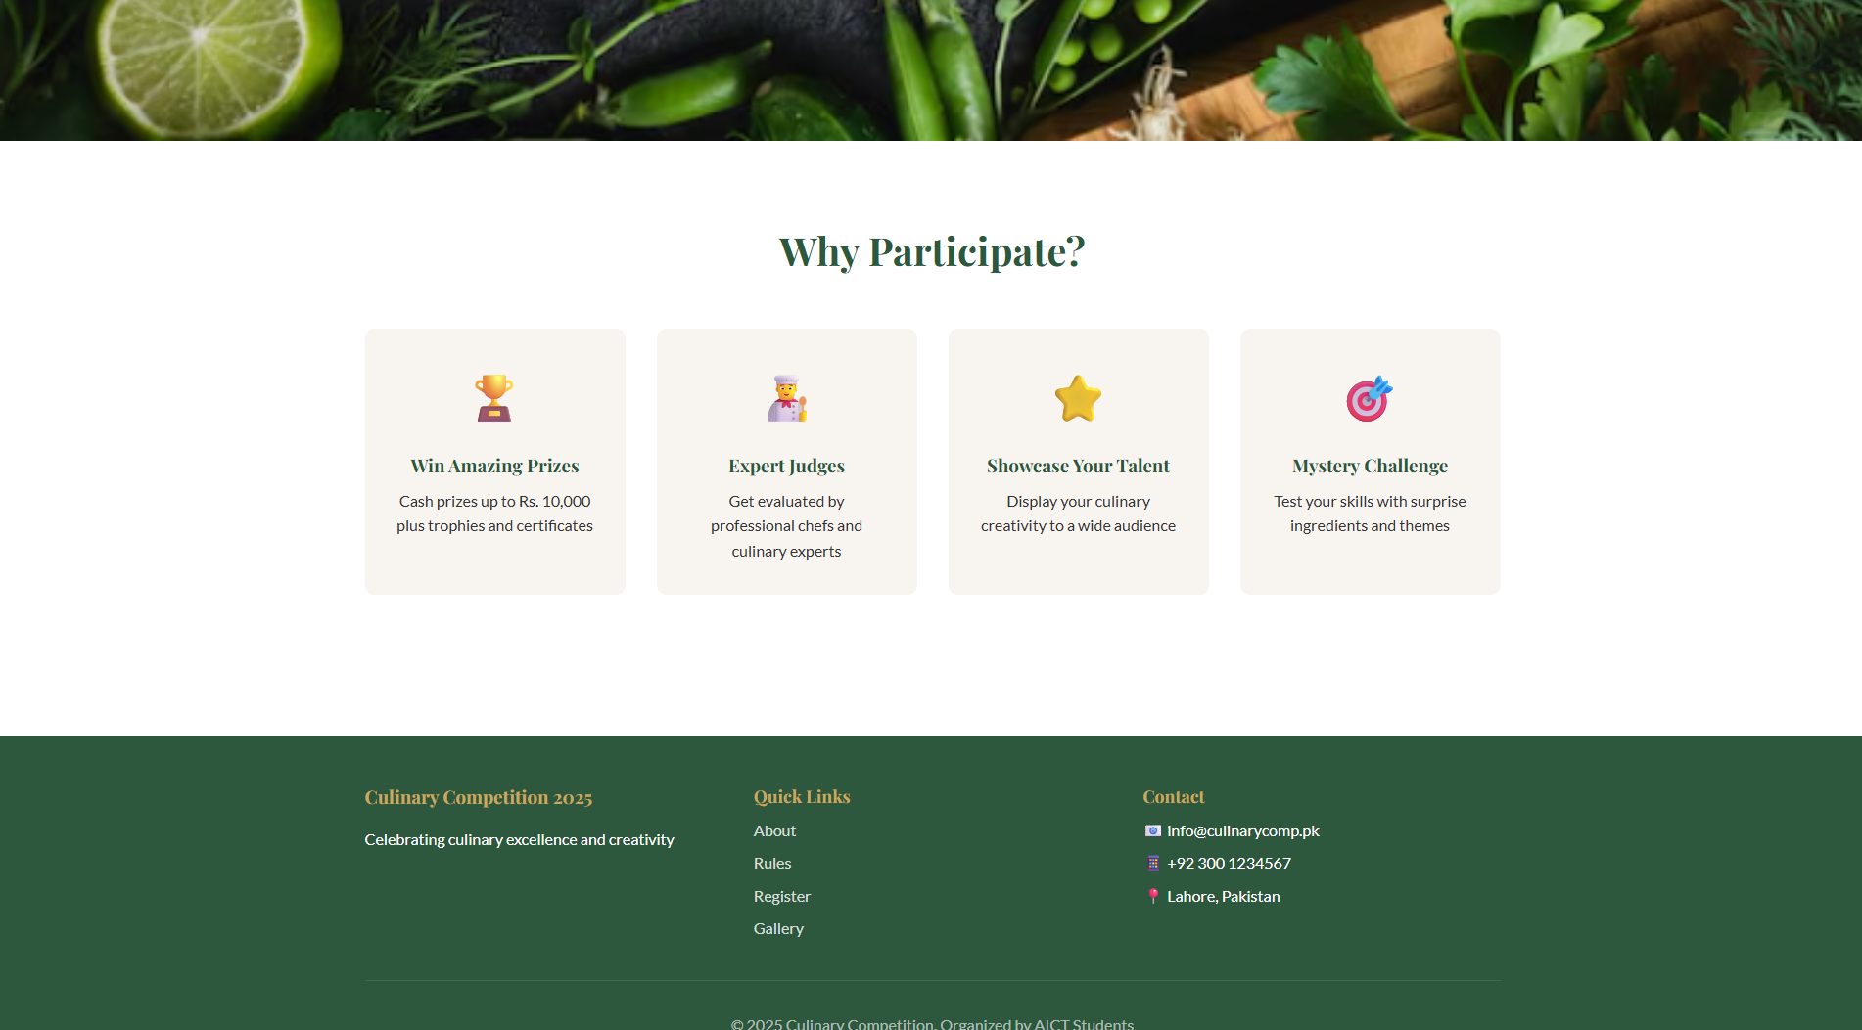
Home Page
Culinary Competition Website
Overview Content :
HTML & CSS based website for Culinary Competition 2025
Home page introduces event theme and purpose
Clear navigation: Home, About, Rules, Register, Gallery, Contact
Call-to-action buttons for quick registration and rules access

Slide 5
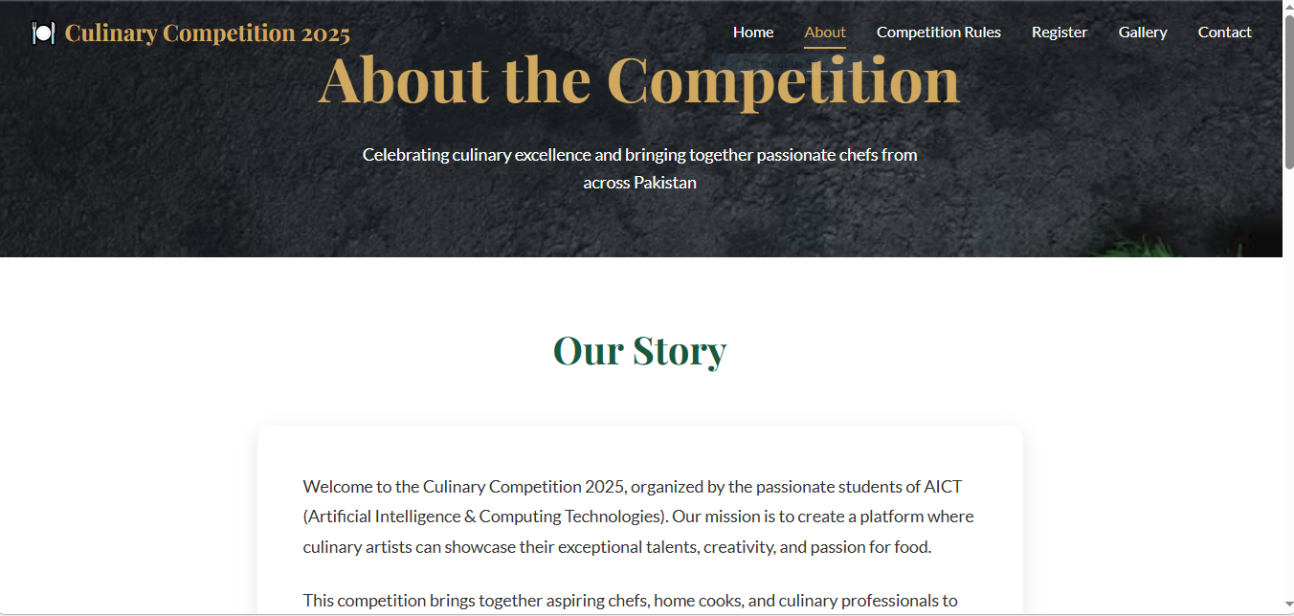
Behind the Apron: About the Competition
Promoting Culinary
Skills
Platform for All
A dedicated space for students and cooking enthusiasts to shine.
We aim to encourage and elevate cooking talents from all backgrounds.
Encouraging Online Participation
Breaking geographical barriers, making the competition accessible to everyone.

Slide 6
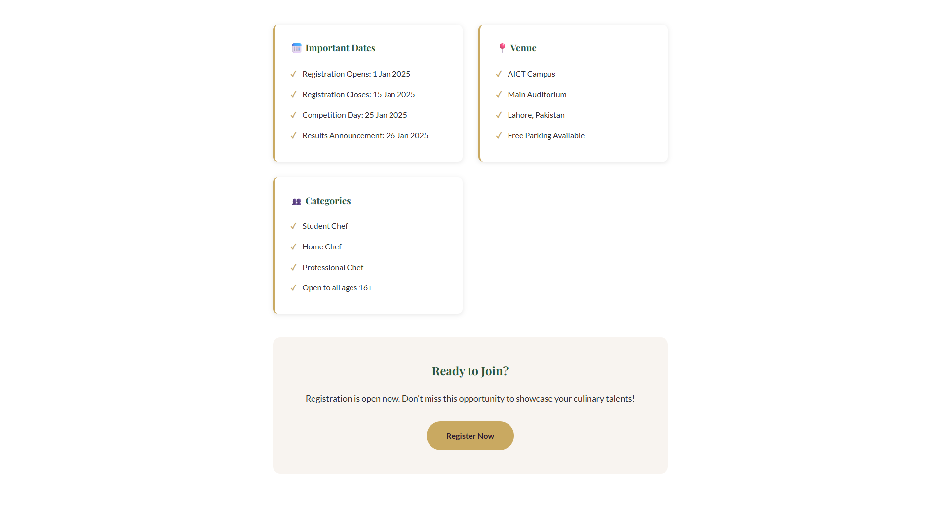
Behind the Apron: About the Competition
Promoting Culinary
Skills
Platform for All
A dedicated space for students and cooking enthusiasts to shine.
We aim to foster and elevate cooking talents from all backgrounds.
Encouraging Online Participation
Breaking geographical barriers, making the competition accessible to everyone.

Slide 7
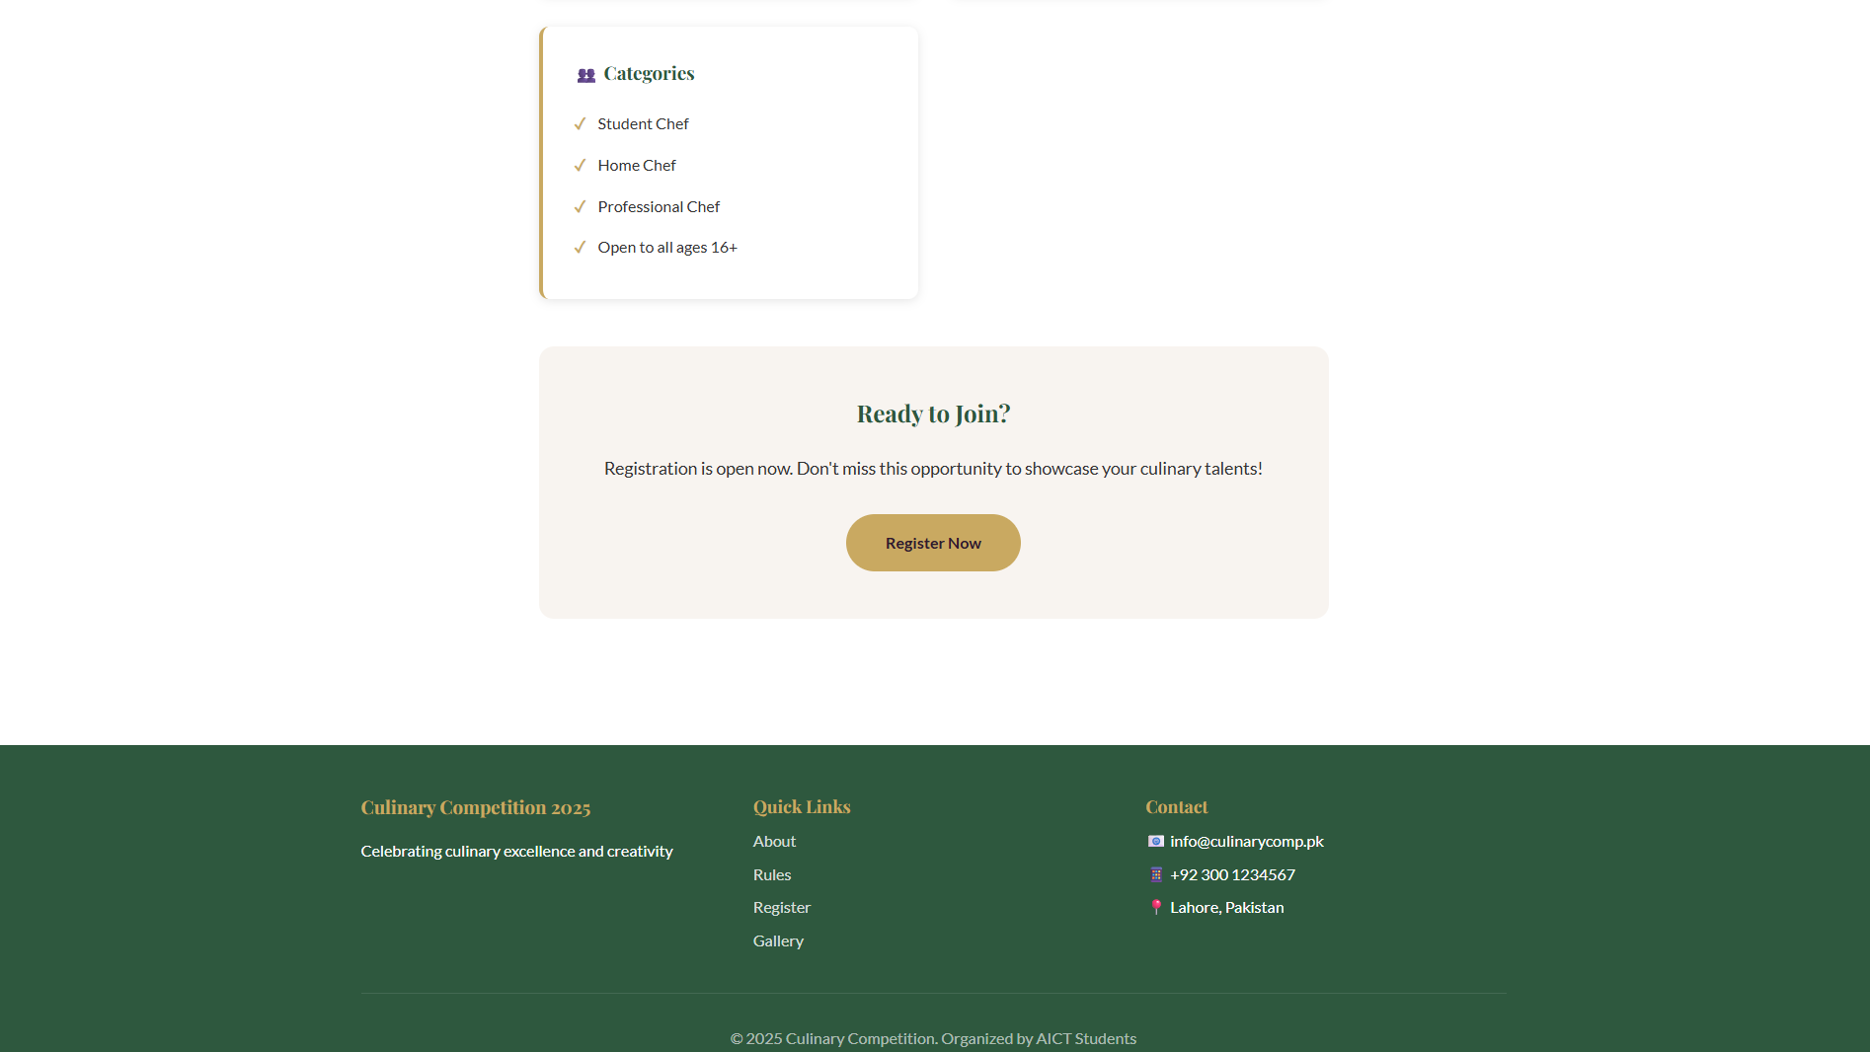
Behind the Apron: About the Competition
Promoting Culinary
Skills
Platform for All
A dedicated space for students and cooking enthusiasts to shine.
We aim to foster and elevate cooking talents from all backgrounds.
Encouraging Online Participation
Breaking geographical barriers, making the competition accessible to everyone.

Slide 8
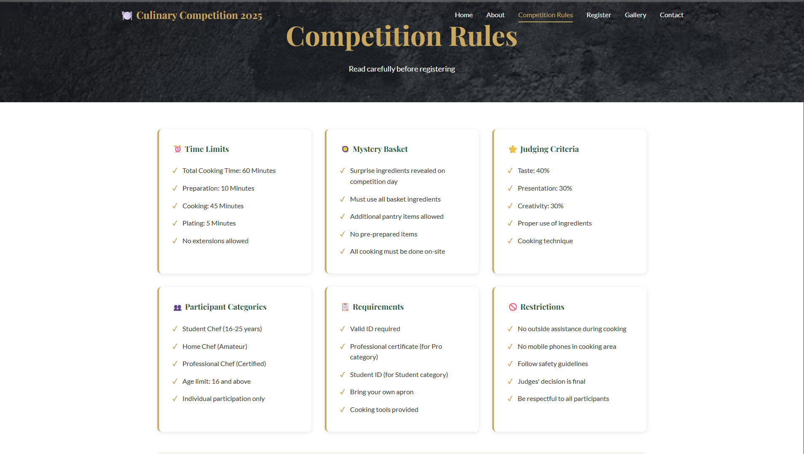
The Recipe for Success: Competition Rules
Clear and concise rules are the foundation of a fair competition. Our dedicated rules page outlines every detail, ensuring transparency and equal opportunity for all participants.
Ensuring Fairness: Detailed guidelines cover all aspects, from ingredient sourcing to presentation.
Submission Guidelines: Step-by-step instructions for submitting dishes, including photo and video requirements.
Judging Criteria: Transparency in how dishes will be evaluated by our esteemed panel of judges.

Slide 9
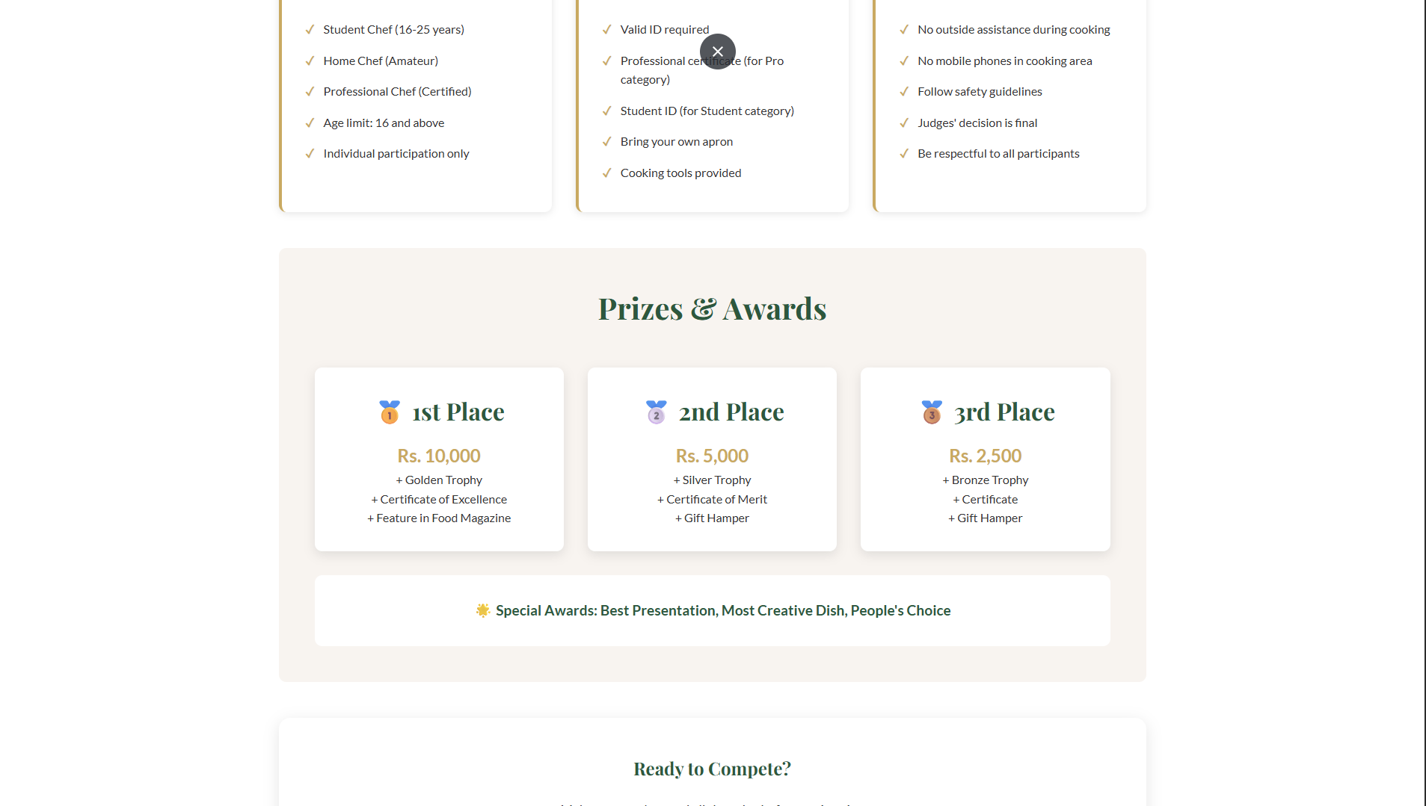
The Recipe for Success: Competition Rules
Clear and concise rules are the foundation of a fair competition. Our dedicated rules page outlines every detail, ensuring transparency and equal opportunity for all participants.
Ensuring Fairness: Detailed guidelines cover all aspects, from ingredient sourcing to presentation.
Submission Guidelines: Step-by-step instructions for submitting dishes, including photo and video requirements.
Judging Criteria: Transparency in how dishes will be evaluated by our esteemed panel of judges.

Slide 10
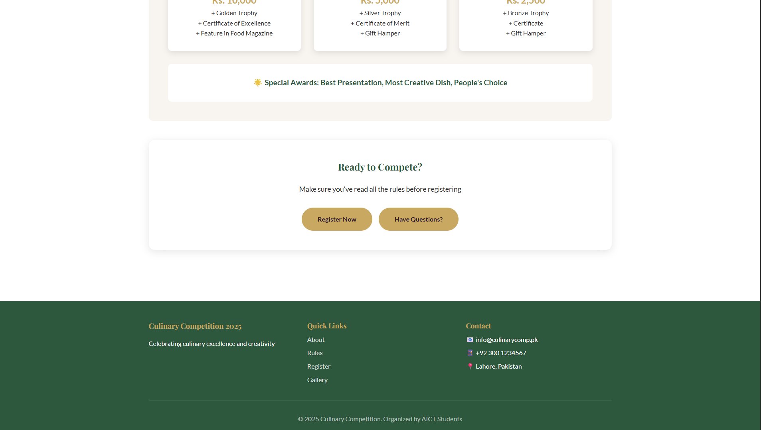
The Recipe for Success: Competition Rules
Clear and concise rules are the foundation of a fair competition. Our dedicated rules page outlines every detail, ensuring transparency and equal opportunity for all participants.
Ensuring Fairness: Detailed guidelines cover all aspects, from ingredient sourcing to presentation.
Submission Guidelines: Step-by-step instructions for submitting dishes, including photo and video requirements.
Judging Criteria: Transparency in how dishes will be evaluated by our esteemed panel of judges.

Slide 11
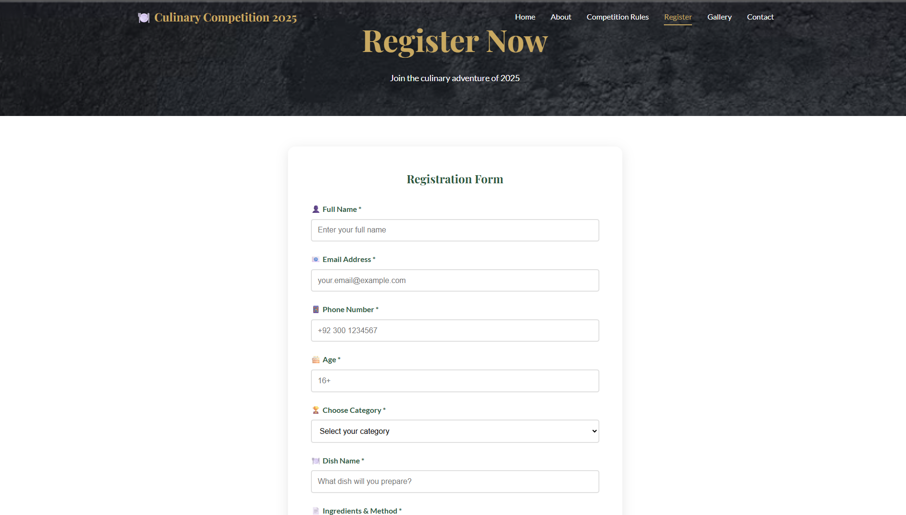
Register Page
Culinary Competition Website
Overview Content :
User-friendly registration form
Collects participant details:
Full Name
Email Address
Phone Number
Age
Category selection
Dish name and ingredients
Simple and clean layout for easy form submission
Encourages quick and smooth registration

Slide 12
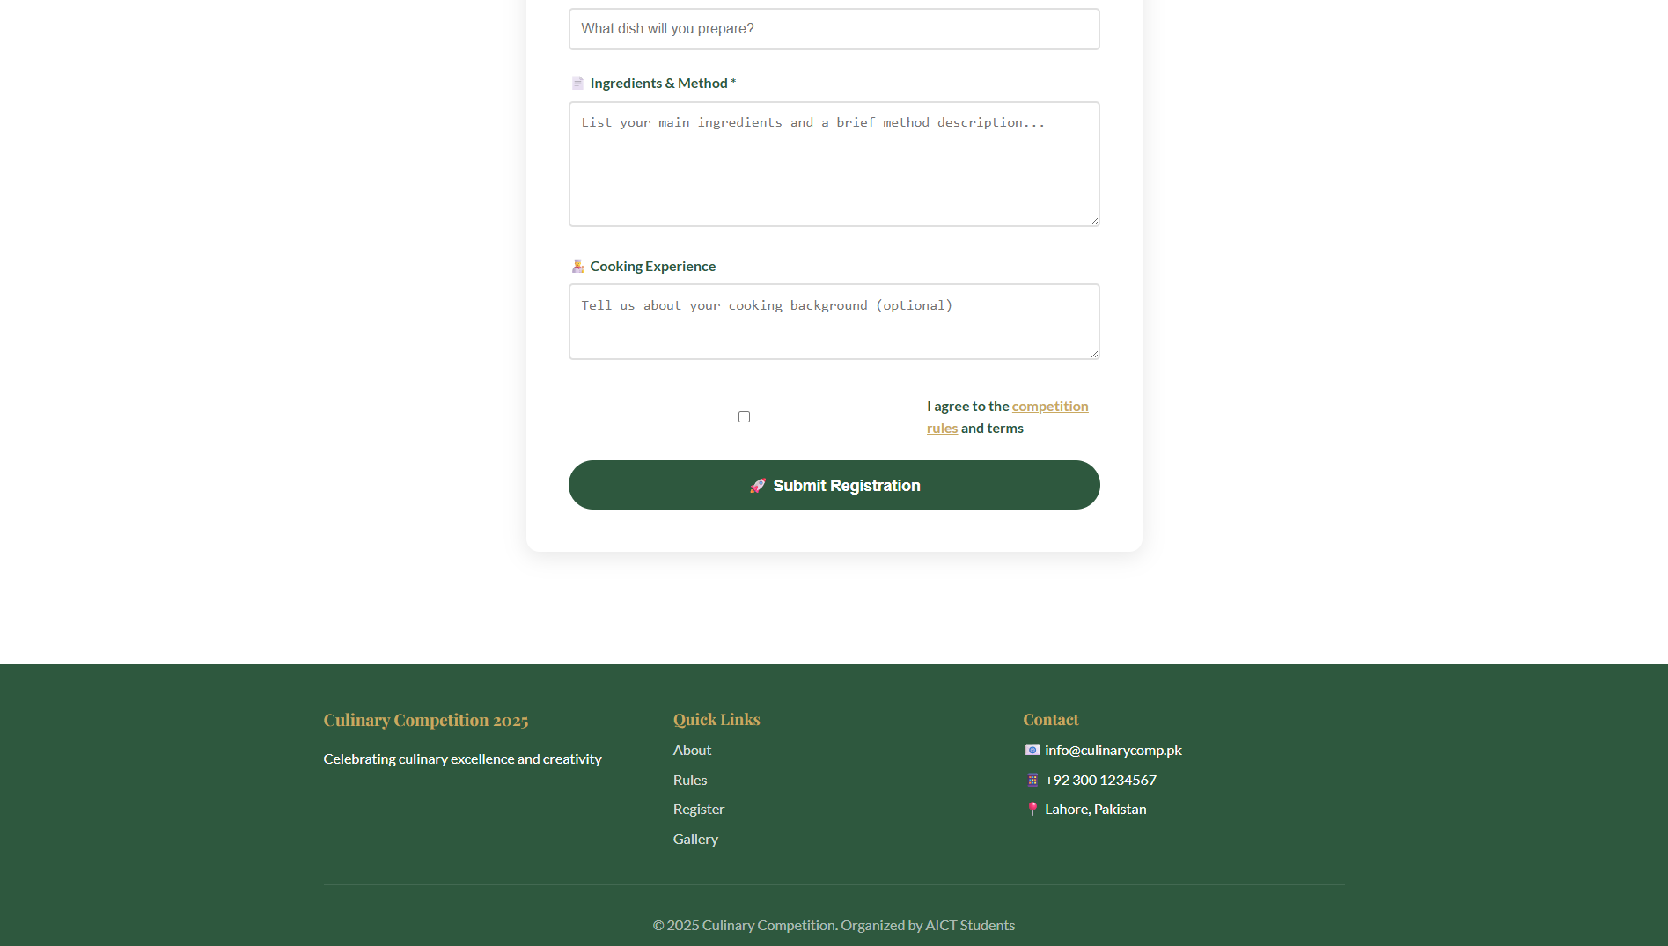
Register Page
Culinary Competition Website
Overview Content :
User-friendly registration form
Collects participant details:
Full Name
Email Address
Phone Number
Age
Category selection
Dish name and ingredients
Simple and clean layout for easy form submission
Encourages quick and smooth registration

Slide 13
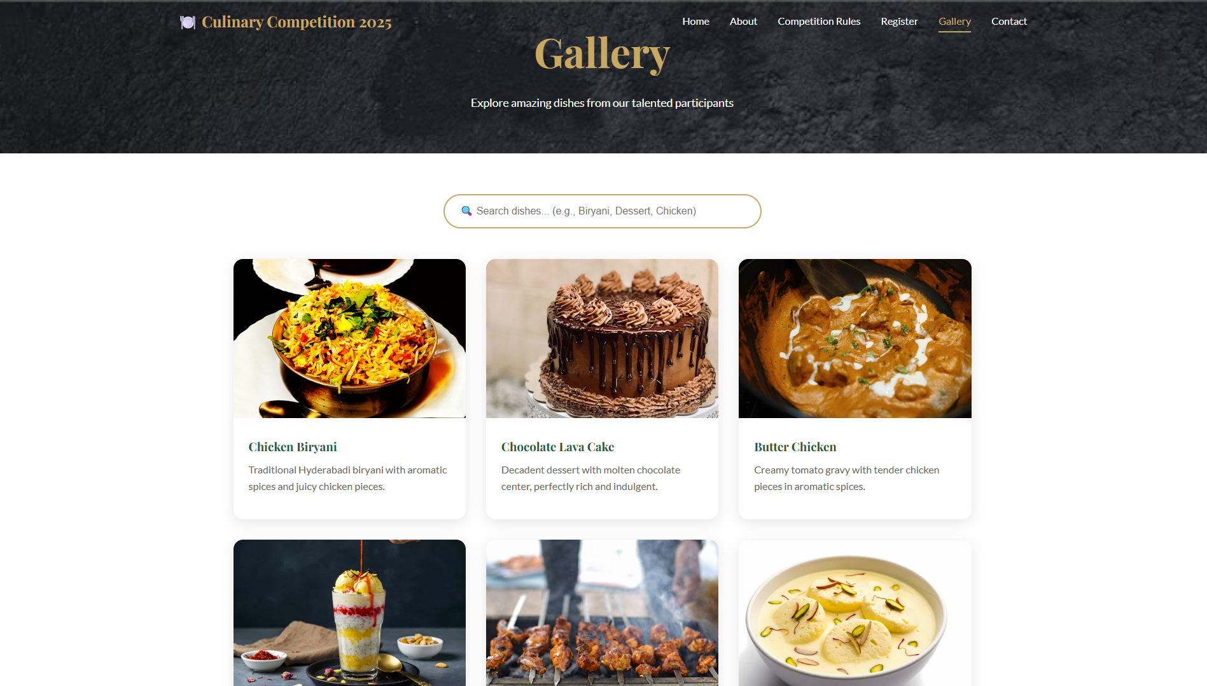
Gallery Page
Culinary Competition Website
Overview Content :
Displays dishes prepared by participants
Image cards with:
Dish name
Short description
Search bar to find dishes easily
Categories like Main Course, Desserts, Snacks
Visually appealing food gallery to attract visitors

Slide 14
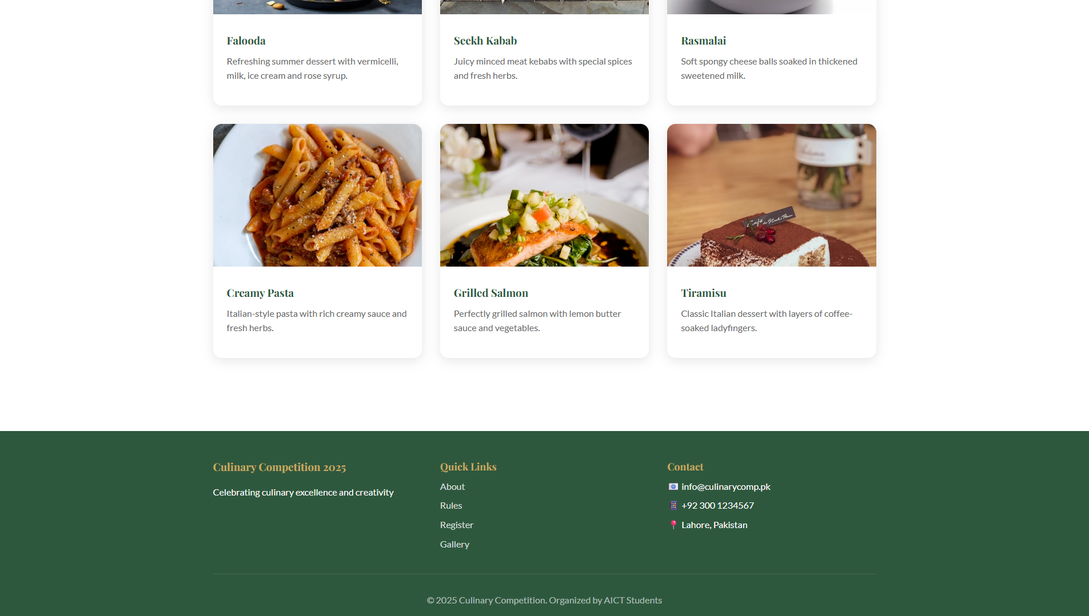
Gallery Page
Culinary Competition Website
Overview Content :
Displays dishes prepared by participants
Image cards with:
Dish name
Short description
Search bar to find dishes easily
Categories like Main Course, Desserts, Snacks
Visually appealing food gallery to attract visitors

Slide 15
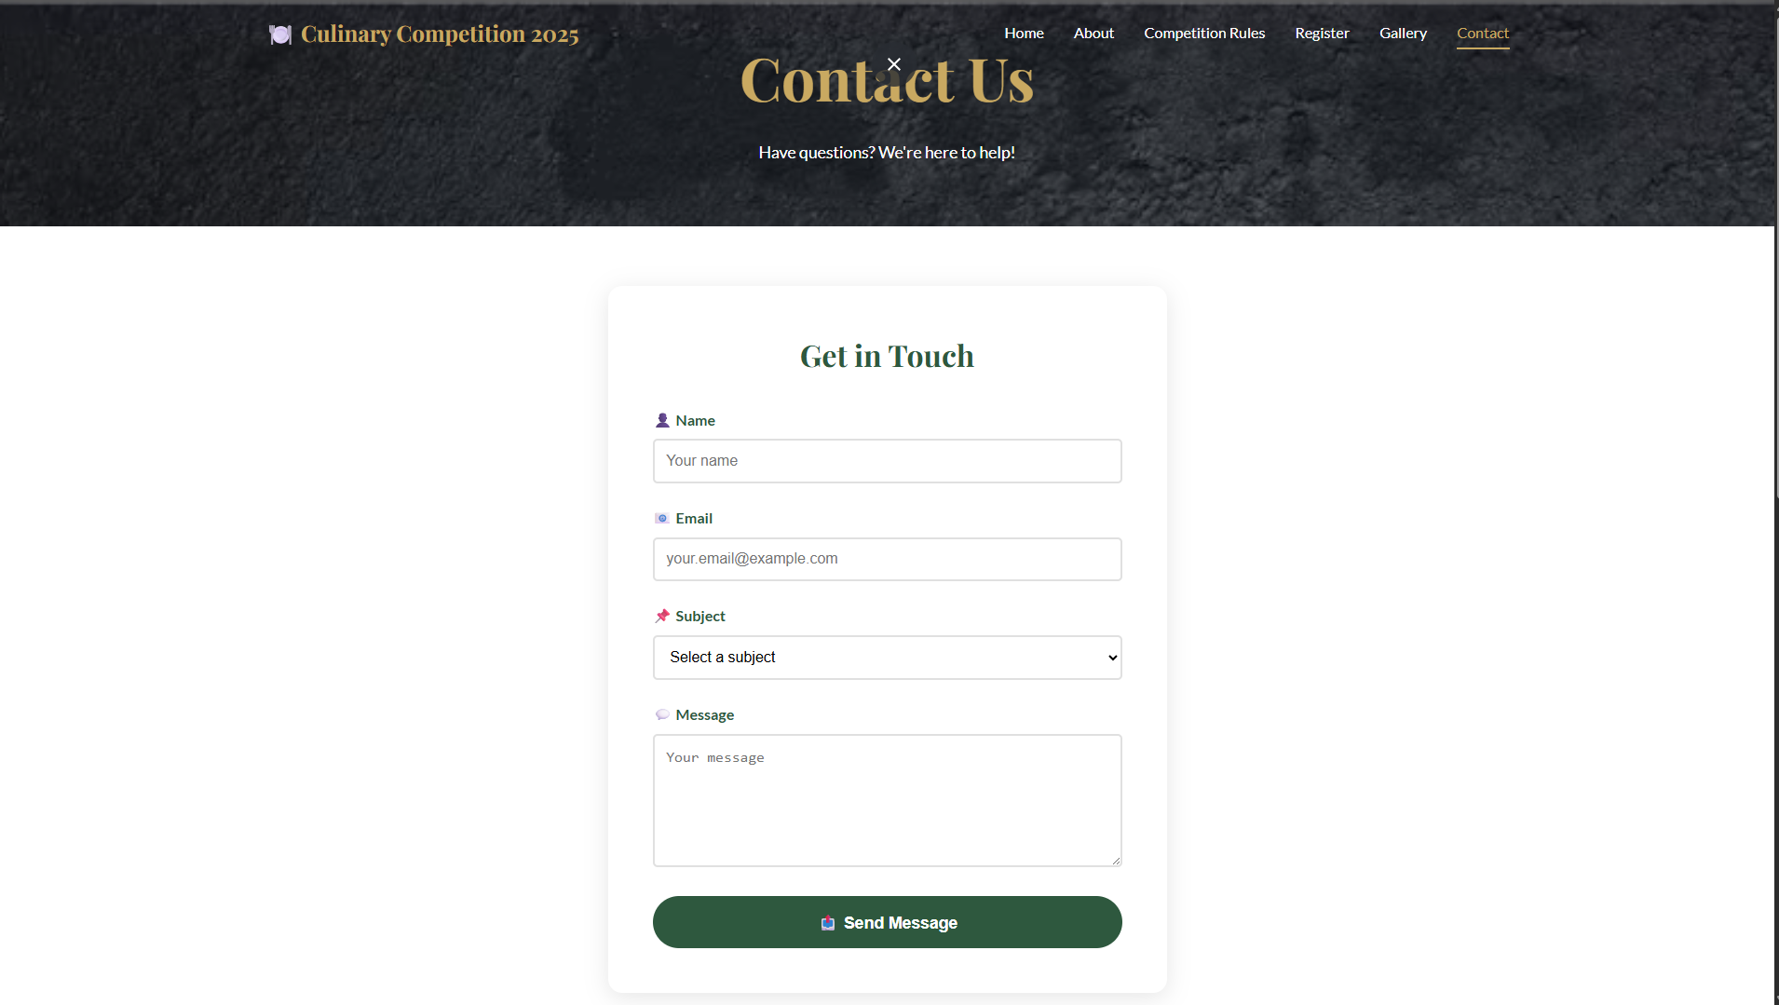
Contact Us Page
Overview Content :
Provides contact details for queries and support
Contact form for user messages
Includes email and phone information
Helps participants communicate easily with organizers

Slide 16
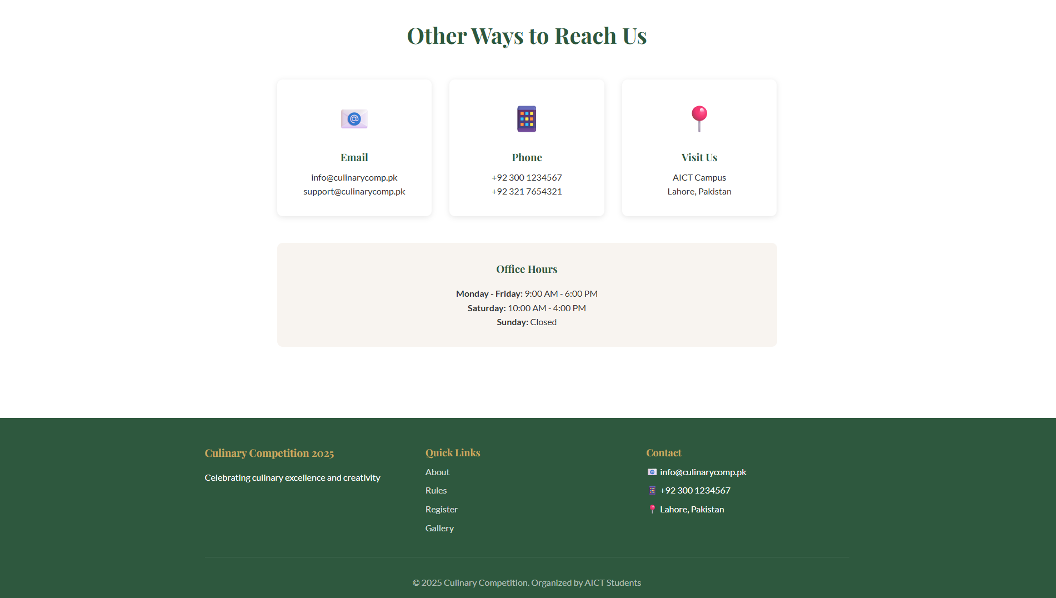
Contact Us Page
Overview Content :
Provides contact details for queries and support
Contact form for user messages
Includes email and phone information
Helps participants communicate easily with organizers

Slide 17
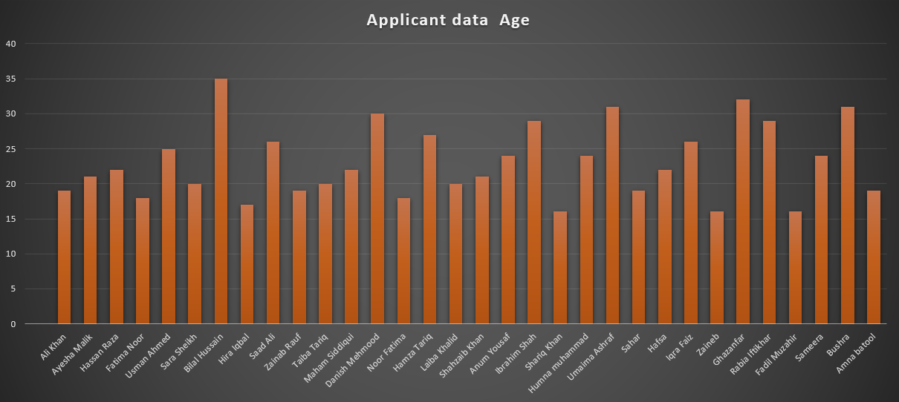
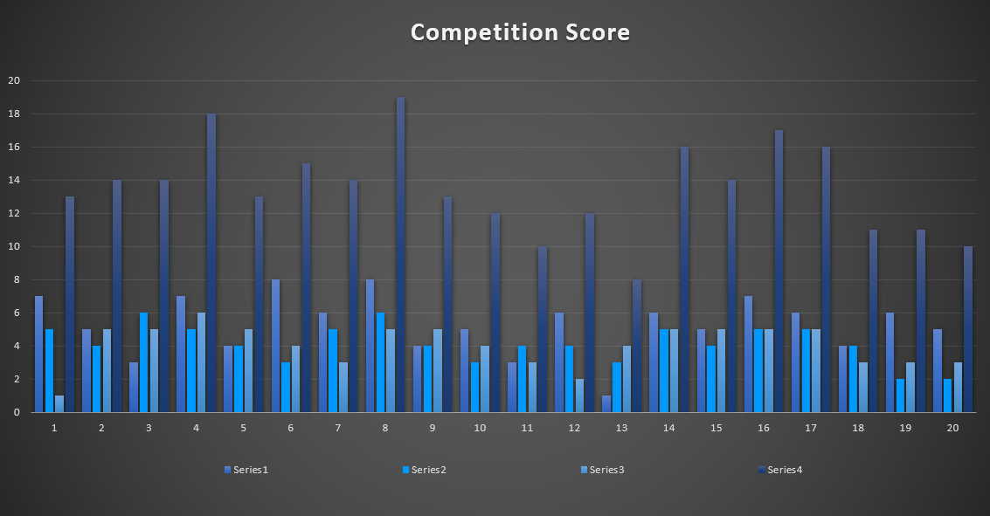
Excel Data
Overview Content :
We organized a culinary competition. The candidate registered by using this website.
There is the statics and screenshot chart of demo excel data.
These are the chart of
applicant ‘s age.
Candidate’s score
Top 5 chef.

Slide 18
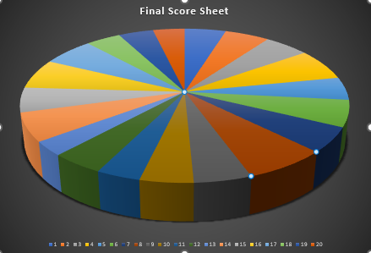
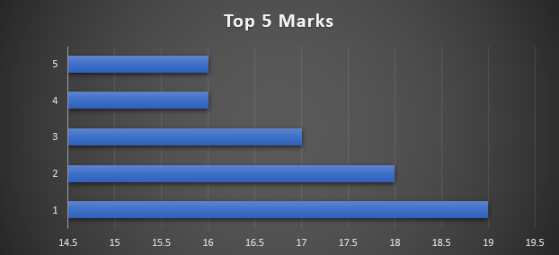
Excel Data
Overview :
We organized a culinary competition. The candidate registered by using this website.
There is the statics and screenshot chart of demo excel data.
These are the chart of
applicant ‘s age.
Candidate’s score
Final score
Top 5 chef

Slide 19
GitHub Repository
Overview :
This is a link of GitHub repository of our live site website culinary competition
https://soaiba-gif.github.io/Culinary-Competition/

